Slide 1
Multimodal AI Framework for Interview Candidate Assessment Using Random Forest Emotion Classification and LLM-Based Competency Evaluation
Student: Toufic Jandah
Supervisor: Professor, Adham Ahmed Awad
Elsayed Elmenshawy
20-Apr-26
Riga, Latvia
Research and Technology – Step into the Future

Slide 2
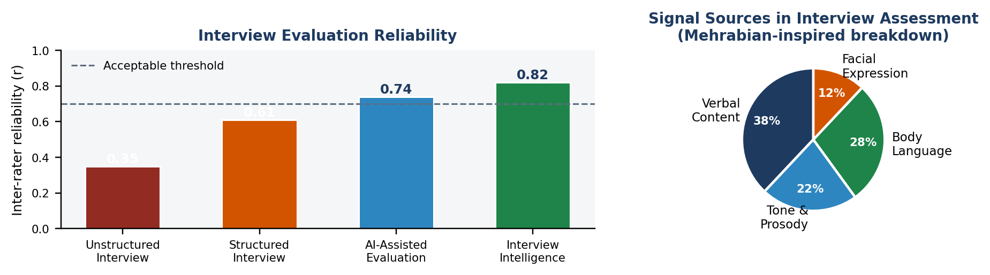
Problem and Motivation
What is the problem and motivation?
Multimodal AI-Based Recruitment Evaluation System
Recruitment interviews are often subjective and inconsistent.
Text-only evaluation can miss important communication signals.
Companies need a structured and explainable way to support interview decisions.
This project proposes a multimodal AI system that combines transcript, speech, and body-language analysis for more transparent evaluation.
Toufic Jandah

Slide 3
Research Question
Research Question?
Multimodal AI-Based Recruitment Evaluation System
How can a human-in-the-loop trimodal AI framework support structured, explainable, and auditable interview candidate assessment?
Sub-questions:
Can a multimodal AI system assess candidate performance by analyzing verbal answers, body language, and speech emotion in real time?
How does combining NLP, computer vision, and audio ML compare with traditional single-modality interview assessment?
What weighted scoring model can best approximate structured human interviewer judgment for confidence, communication, and competence?
How can explainability, audit logging, and human override reduce ethical and regulatory risks in AI-assisted recruitment?
Toufic Jandah

Slide 4
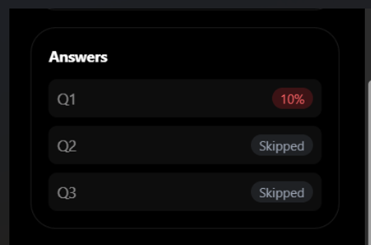
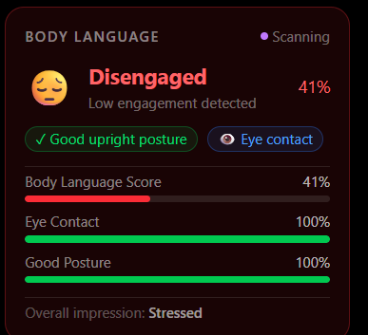
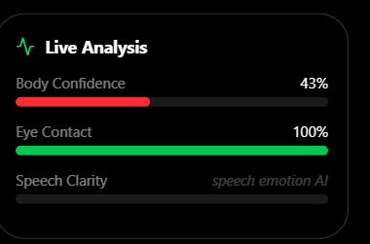
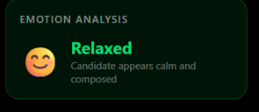
System Overview
Multimodal AI-Based Recruitment Evaluation System
System Overview
The proposed system evaluates interviews using three input sources: transcript, speech, and body language.
It combines these signals into a structured AI based evaluation.
The platform is designed to be explainable, auditable, and supportive of human decision-making.
Final results help reviewers assess candidates more consistently.
Toufic Jandah

Slide 5
Objectives
Objective of study
Multimodal AI-Based Recruitment Evaluation System
To design, implement, and evaluate a multimodal AI-based recruitment evaluation system that supports structured, explainable, and human-controlled interview assessment.
Objectives:
Review existing AI-based recruitment and interview evaluation approaches.
Identify the limitations of manual, text-only, and fully automated evaluation methods.
Design a multimodal system using transcript, speech, and body-language inputs.
Implement AI services for answer evaluation, speech emotion analysis, and body-language analysis.
Develop transparent competency scoring and recommendation logic.
Align the system with explainability, auditability, and EU AI Act requirements.
Evaluate the system through an illustrative interview session and system output.
Toufic Jandah
5

Slide 6
Literature Review
Literature Review
Multimodal AI-Based Recruitment Evaluation System
Previous research shows that AI can improve decision support systems by making evaluation more structured, data-driven, and consistent. In interview evaluation, three research areas are especially relevant:
Text and transcript analysis Natural language processing and large language models can evaluate answer relevance, evidence quality, role fit, and communication clarity.
Speech emotion analysis Audio features such as MFCCs, chroma, RMS energy, zero-crossing rate, and spectral rolloff can be used to detect emotional patterns such as stress, confidence, or nervousness.
Body-language and visual analysis Computer vision techniques can estimate posture, eye contact, facial orientation, gestures, and engagement-related behaviour.
However, existing research also highlights ethical concerns: AI-based recruitment tools may introduce bias, over-interpret non-verbal signals, or create hidden automatic decision rules. Therefore, explainability and human oversight are necessary.
Toufic Jandah
6

Slide 7
Research Methodology
Research Methodology
Multimodal AI-Based Recruitment Evaluation System
The research follows a design-and-implementation methodology:
Problem analysis Identify subjectivity, inconsistency, and lack of explainability in recruitment interviews.
Literature and market review Compare existing recruitment evaluation methods, AI interview tools, and regulatory requirements.
System design Define the multimodal architecture, input channels, scoring logic, and human-review process.
Implementation Develop the frontend, AI services, LLM evaluation, database storage, and audit logging
Evaluation Test the system using an illustrative interview scenario and assess whether outputs are explainable, structured, and reviewable.
Ethical and regulatory analysis Assess how the system avoids fully automated hiring and supports human oversight.
Toufic Jandah
7

Slide 8
System Architecture
Study Architecture Multimodal AI-Based Recruitment Evaluation System
This slide presents the overall architecture of the proposed multimodal AI-based interview evaluation system.
Specifically:
Frontend: Next.js interface for conducting the interview .
AI services: speech emotion analysis and body-language analysis.
LLM evaluation: analyzes transcript answers and scores competencies.
Database/storage: stores scores, feedback, logs, and interview results.
Toufic Jandah

Slide 9
Research Gap, Market Comparison
Existing Approaches Multimodal AI-Based Recruitment Evaluation System
Approach | Description | Limitations
Rule-based interview scoring | Uses fixed rubrics, checklists, or manually defined scoring rules | Rigid, limited adaptability, and may miss nuanced candidate signals
Traditional interviews | Human judgment based on notes and impressions | Subjective and inconsistent
Structured interviews | Same questions and scoring rubric | Still depends on human interpretation
AI text-only evaluation | Scores transcript answers | Misses speech and body-language signals
Multimodal AI evaluation | Uses transcript, speech, and body language | Needs explainability and human oversight
Why multimodal? It captures richer interview signals than text-only methods while supporting more structured evaluation.
Toufic Jandah

Slide 10
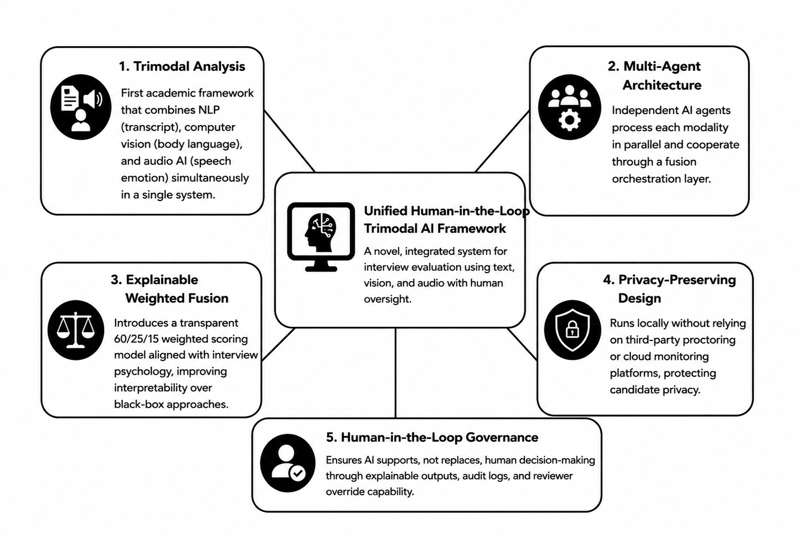
Scientific Novelty
Existing Approaches Multimodal AI-Based Recruitment Evaluation System
Toufic Jandah

Slide 11

System Architecture and Proposed Framework
System Overview & Proposed Framework Multimodal AI-Based Recruitment Evaluation System
Guided
interview
Transcript
analysis
Audio AI
service
Body AI
service
Role
criteria
Audit log
& storage
Combines browser-side inference, two custom ML APIs, LLM answer scoring, O*NET competency lookup, persistent storage, and audit logging.
Stores explainable results with an auditable human-override flow instead of fully autonomous hiring decisions.
Interview conductor
ML sidecars
Persistence
GPT-4o or GPT-4o-mini guides the interview, asks questions, and evaluates answers using structured prompts.
Python services provide speech emotion prediction and body-language analytics in real time.
Scores, telemetry, evidence quotes, logs, and exports are stored for later review.
Toufic Jandah

Slide 12
Type of AI Agents in the System
System Overview & Proposed Framework Multimodal AI-Based Recruitment Evaluation System
The platform is best described as a cooperative multi-agent AI decision-support system.
Answer Evaluator: LLM Agent,Evaluates transcript answers against a structured rubric: relevance, communication, evidence, role fit.
Body Language Analyzer: Computer Vision ML Agent, Uses MediaPipe landmarks and Random Forest to estimate posture, engagement, and behavioral state.
Speech Emotion Detector:Audio ML Agent, Uses MFCC, chroma, RMS, and spectral features to classify relaxed, happy, stressed, or nervous states.
Fusion Orchestrator: Rule Based Agent, Combines stream outputs using transparent weights and produces a reviewable recommendation.
Toufic Jandah

Slide 13
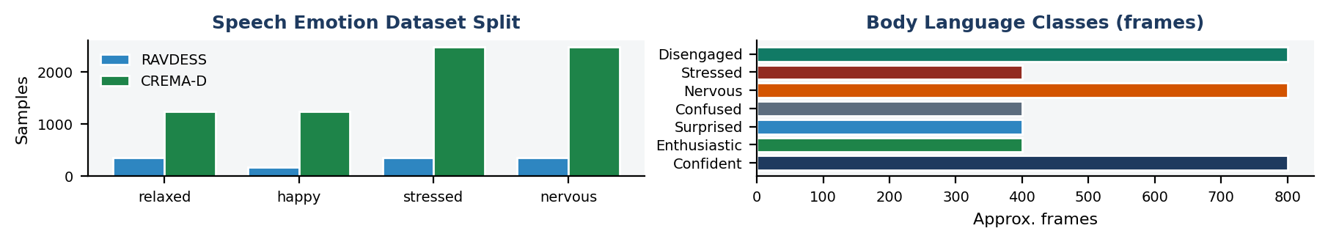
Datasets and Training Pipelines
Datasets and Training Pipelines Multimodal AI-Based Recruitment Evaluation System
Speech emotion datasets
Body-language dataset
Model pipelines
RAVDESS
• ~1,440 WAV files
• 24 actors
• 8 original emotions remapped to 4 classes
CREMA-D
• ~7,442 WAV files
• 91 actors
• Combined training set: ~8,882 samples
Output classes
relaxed, happy, stressed, nervous
10 MP4 videos covering behavioral states
• ~400 frames sampled per video with OpenCV
• MediaPipe pose: 33 keypoints × 3 = 99 features
• MediaPipe face: 478 landmarks × 3 = 1,434 features
• Total per-frame vector: 1,533 features
Target classes
Confident, Enthusiastic, Surprised, Confused, Nervous, Stressed, Disengaged
Speech model
Raw WAV → feature extraction → StandardScaler → RandomForest → 4-class output
Body-language model
Frames → landmarks → StandardScaler → RandomForest → 7-class output
Saved artifacts
emotion_model.pkl
body_language_model.pkl
Toufic Jandah

Slide 14
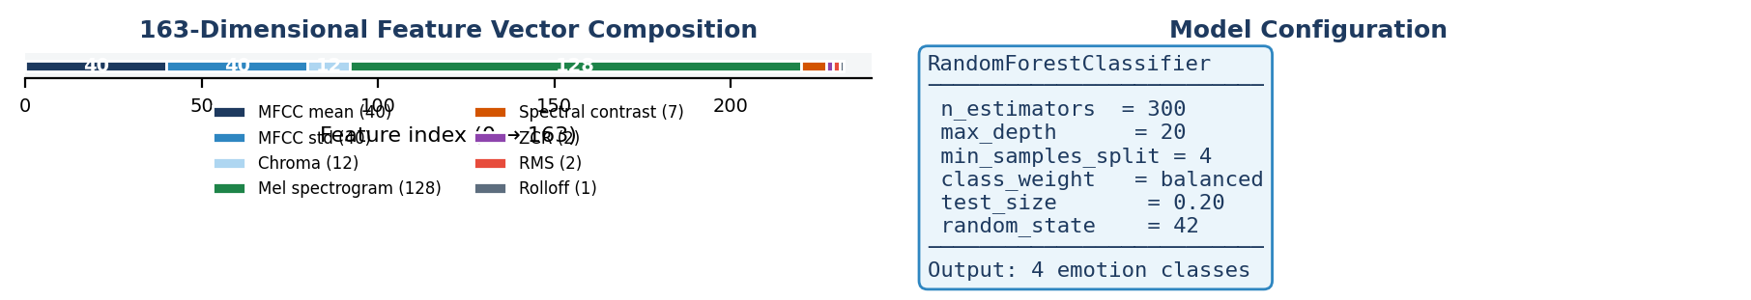
Speech Emotions Analysis Service
Speech Emotions Analaysis Services Multimodal AI-Based Recruitment Evaluation System
Feature extraction and formulas
Hyperparameters
Audio clip → 163-dimensional vector → StandardScaler → RandomForest classifier
Key formulas
Mel scale: m = 2595 log10(1 + f/700)
Zero-crossing rate: counts sign changes in the waveform
RMS energy: square-root mean power of the signal
Spectral rolloff: frequency below which 85% of energy is contained
Feature composition
40 MFCC mean + 40 MFCC std + 12 chroma + spectral / energy features.
RandomForest
• n_estimators = 300
• max_depth = 20
• min_samples_split = 4
• class_weight = balanced
• 80/20 train-test split
Interpretation
The speech service turns raw signal behavior into stable interview-friendly categories.
remapping
neutral/calm → relaxed
happy → happy
angry/disgust → stressed
fearful/sad → nervous
Toufic Jandah

Slide 15
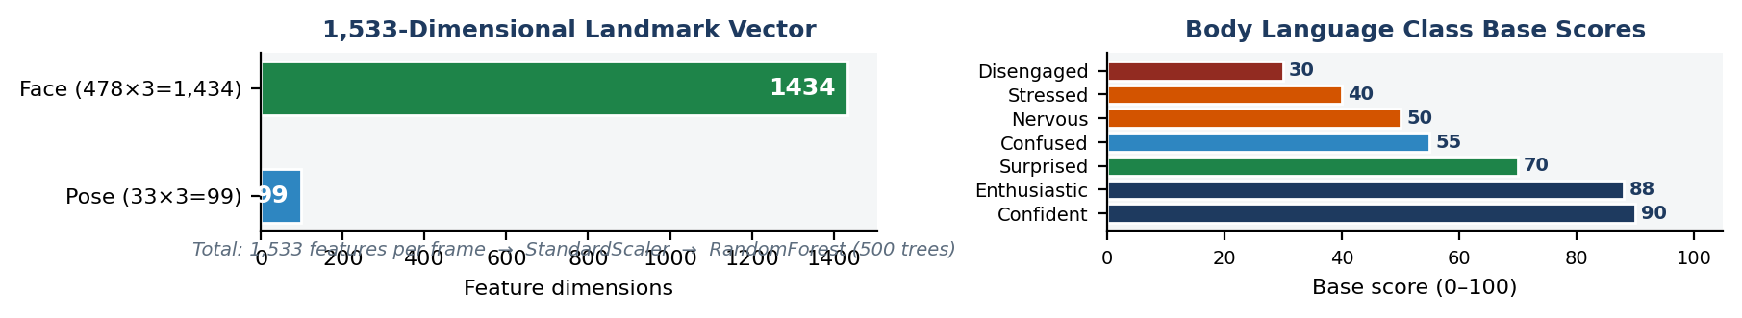
Body Language Analysis Service
Body Language Analaysis Service Multimodal AI-Based Recruitment Evaluation System
Heuristics and scoring
Model setup
MediaPipe landmarks are converted into posture, eye contact, gestures, and a composite body-language score.
Lean detection
| mean(shoulders_x) − mean(hips_x) | > 0.12 → leaning
Shoulder symmetry
| y_LS − y_RS | > 0.05 → slouching
Eye contact
0.4 ≤ nose_x ≤ 0.6 and 0.3 ≤ nose_y ≤ 0.7
Score
base × (confidence/100) × 0.6 + base × 0.4
+ 8 if eye contact + 7 if posture = good + 3 if gesturing
cap at 100
RandomForest
• n_estimators = 500
• max_depth = 25
• min_samples_split = 3
• class_weight = balanced
• 80/20 split
Class mapping
Base scores
Confident 90
Enthusiastic 88
Surprised 70
Confused 55
Nervous 50
Stressed 40
Disengaged 30
This keeps the output explainable and decomposable by factor.
Toufic Jandah

Slide 16
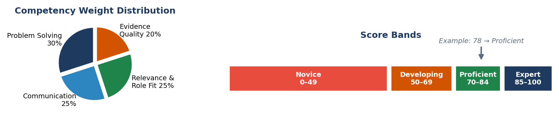
Competency Scoring and Hiring Logic
Competency Scoring and Hiring Logic
Multimodal AI-Based Recruitment Evaluation System
Weighted competency rubric
Recommendation rules
Final Score = 0.25 × Communication
+ 0.30 × Problem Solving
+ 0.25 × Relevance & Role Fit
+ 0.20 × Evidence Quality
Worked example
80, 75, 85, 70 → 77.75 ≈ 78/100
Banding
85–100 Expert
70–84 Proficient
50–69 Developing
0–49 Novice
overall ≥ 85 and no novice competency → Strong Yes
overall ≥ 70 and no novice competency → Yes
overall ≥ 50 → Maybe
otherwise → No
Why this is safer
A high average is not enough if one competency remains weak.
The recommendation is advisory only and can be overridden by a human reviewer.
Evaluation uses lower temperature prompts for reproducibility.
Toufic Jandah

Slide 17
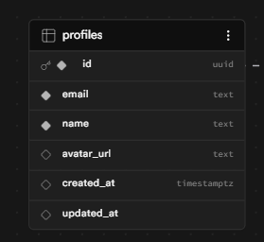
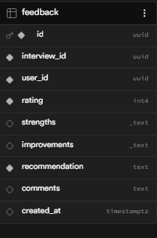
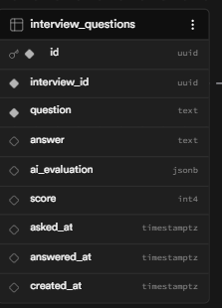
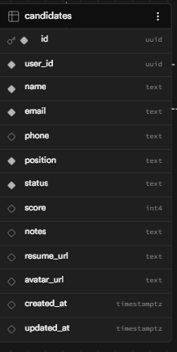
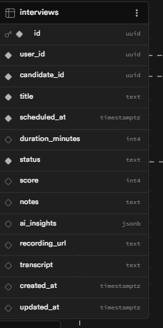
APIs, Database Schema, and Storage Design
APIs, Database Schema, and Storage Design
Multimodal AI-Based Recruitment Evaluation System
External and internal APIs
Database and security design
OpenAI GPT-4o-mini
• Interview conduction, answer evaluation, feedback
O*NET Web Services
• Role-specific competencies, skills, and knowledge
Google OAuth + Supabase APIs
• Login, CRUD, and storage access
Local FastAPI sidecars
• Speech emotion prediction (:8000)
• Body-language prediction (:8001)
profiles → id, email, name
candidates → position, status, score
interviews → scheduled_at, score, ai_insights, recording_url
feedback → strengths, improvements, recommendation
Design choices
• JSONB for flexible AI output storage
• UUID primary keys
• Row-Level Security for isolation
• Signed URLs for recordings
Toufic Jandah

Slide 18
Explainability and EU AI Act Aligned Design
Explainability and EU AI Act Aligned Design Multimodal AI-Based Recruitment Evaluation System
Non-verbal signals must not become hidden automatic rejection criteria.
Face and emotion data are displayed only and are not used in final hiring scores.
Scoring is based on transcript content and transparent competency formulas.
Human review and override remain mandatory.
Every AI event, export, and manual override is logged.
The platform supports recommendation, evidence review, and governance.
Multimodal signals are used for context, coaching, research telemetry, and auditable summaries.
The system is designed to remain explainable, reviewable, and overrideable.
Toufic Jandah

Slide 19
Regulatory, Ethical, and Economic Context
Explainability and EU AI Act Aligned Design Multimodal AI-Based Recruitment Evaluation System
AI recruitment systems are important because they affect both:
business productivity, by reducing manual review time and supporting more structured candidate evaluation.
individual opportunities, because hiring decisions affect access to employment. Under the EU AI Act, recruitment-related AI requires careful attention to:
Scoring is based on transcript content and transparent competency formulas.
transparency human oversight fairness and bias control auditability data protection accountability
Design response in this project
keeping recommendations advisory, requiring human review and override, logging AI outputs and reviewer actions, using transparent competency-based scoring, keeping non-verbal indicators separate from final hiring decisions.
Toufic Jandah

Slide 20
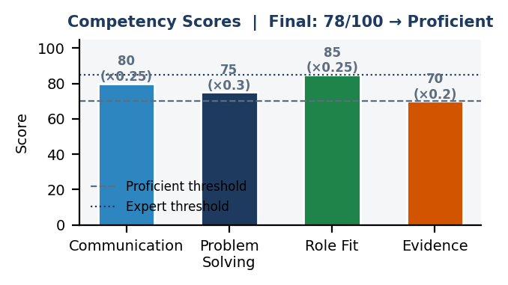
Multimodal AI-Based Recruitment Evaluation System
Illustrative Session Output and Results
Illustrative Session Output and Results
Example interview workspace
Answer evaluation
Candidate video feed with landmarks
Emotion panel: happy 82%
Body language: confident 88
Transcript snippet:
“In my internship, I redesigned the API workflow, reduced response time by 35%, and coordinated testing with two teammates before release.”
Examiner focus
• multimodal fusion, not just text scoring
• interpretable rules and thresholds
• role-specific criteria
• full audit trail
Criteria: Explainability, Consistency, Auditability, Human Oversight, Multimodal Utility, Ethical Safety
Communication
80
Problem Solving
75
Role Fit
85
Evidence
70
Final recommendation
Overall score: 78/100
Recommendation: Yes / Strong candidate
Human reviewer can confirm or override before export.
Toufic Jandah

Slide 21
Conclusions
Conclusions
Multimodal AI-Based Recruitment Evaluation System
This research shows that a multimodal AI recruitment system can support fairer and more consistent interview assessment by combining transcript, speech, and body-language analysis into a structured workflow, while explainable scoring, audit logs, and mandatory human override keep the final hiring decision under human control.
The system combines browser sensing, custom ML services, LLM scoring, and occupational knowledge lookup in one workflow.
It defines explicit mathematical rules for body-language scoring and competency aggregation.
Audit logging, human override, and explainable exports support transparent decision-making.
Non-verbal analytics are separated from the final hiring decision to reduce ethical and regulatory risk.
Toufic Jandah

Slide 22
Future Work
Future Work Multimodal AI-Based Recruitment Evaluation System
Larger multimodal datasets: Improve the robustness of the system by collecting more interview data across different roles, speaking styles, and candidate profiles..
Temporal sequence models: Extend the current approach with sequence-based models to better capture changes in speech and body language over time.
Broader role benchmarking: Evaluate the platform across more job categories to validate the role-specific scoring logic under different hiring contexts.
Fairness calibration: Compare AI-supported evaluation with human interviewers to improve consistency, reduce bias, and calibrate scoring thresholds.
Stronger explainability tools: Add clearer evidence summaries and reviewer-facing explanations to make recommendations easier to interpret and justify.
Deployment and scalability: Optimize the platform for wider real-time use, including faster inference, more reliable APIs, and smoother enterprise deployment.
Github Link: https://github.com/TAJKING10/theiss
Toufic Jandah

Slide 23
THANK YOU FOR ATTENTION!
Toufic Jandah
Toufic-Jandah@hotmail.com
Demo Video: https://youtu.be/CO4d5y-fKm8 `
Github Link: https://github.com/TAJKING10/theiss
20-Apr-26
Riga, Latvia
Research and Technology – Step into the Future

